Slide 1







Semi-Supervised Temporal Action Detection
with Proposal-Free Masking
Sauradip Nag^{1,2} Xiatian Zhu^{2,3} Yi-Zhe Song^{1,2} Tao Xiang^{1,2}
¹CVSSP, University of Surrey, UK
²iFlyTek-Surrey Joint Research Centre for Artificial Intelligence
³Surrey Institute for People-Centred Artificial Intelligence, University of Surrey, UK

Slide 2

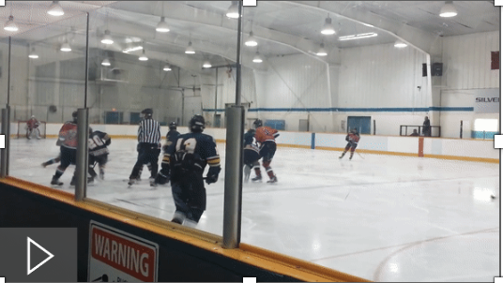
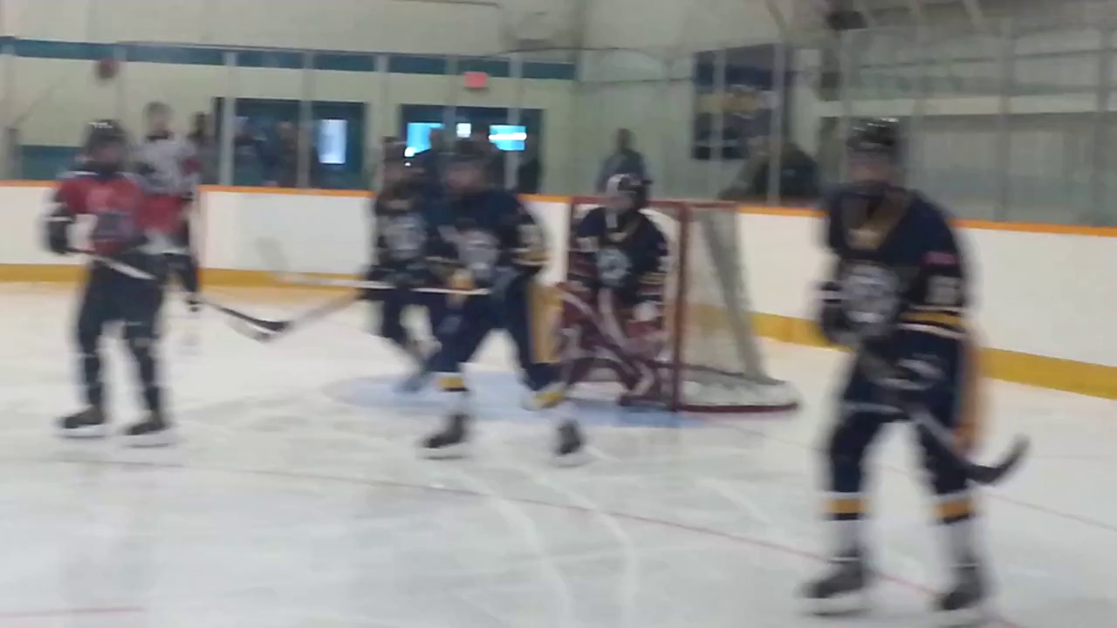
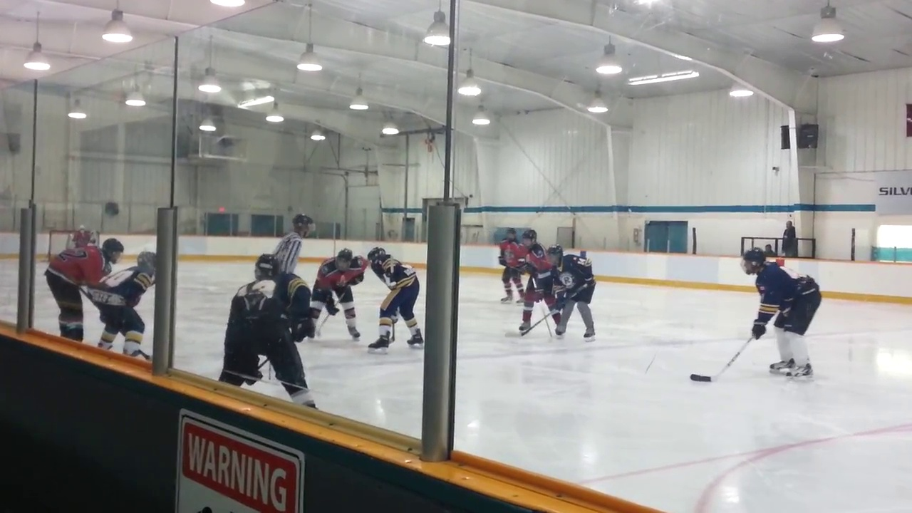
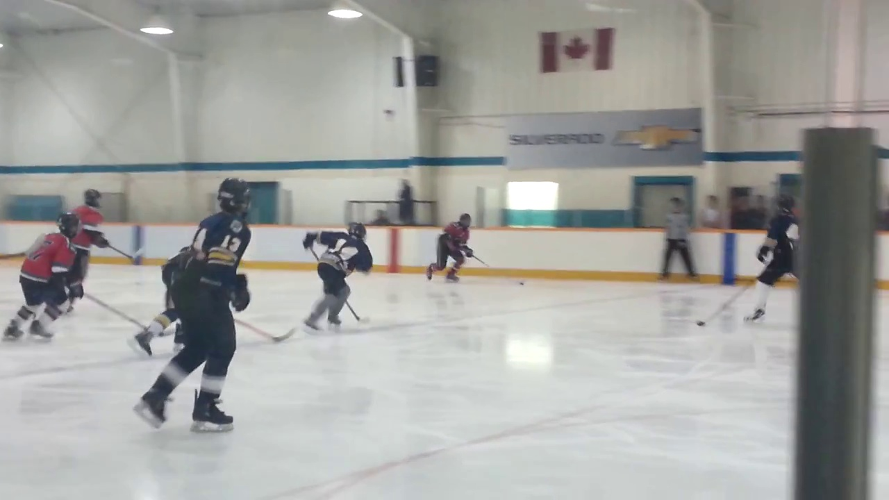
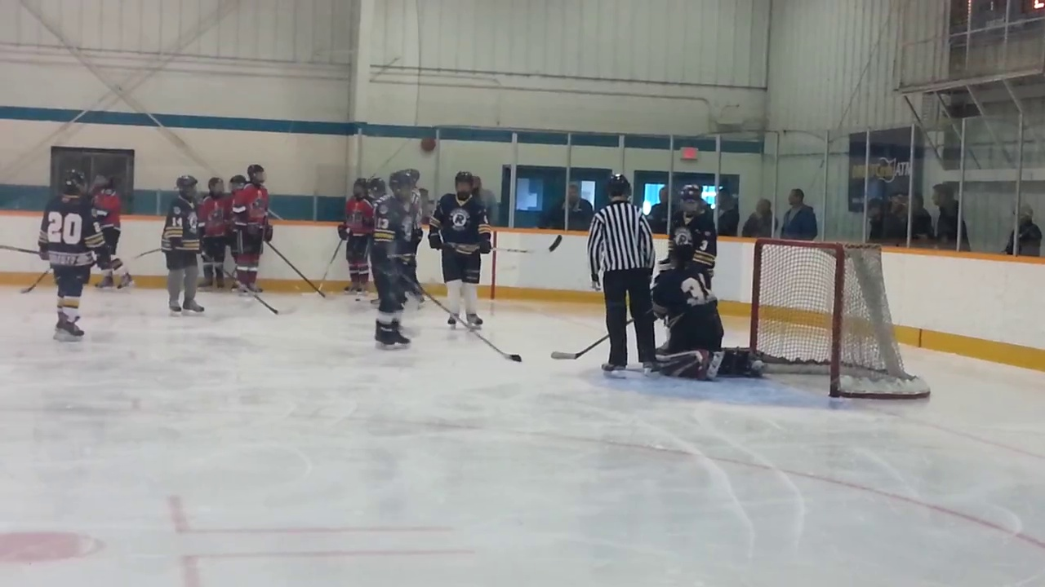
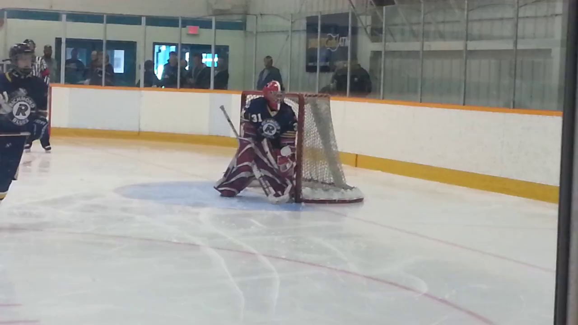
What is Temporal Action Detection ?
What is the Activity ?
(“Playing Ice Hockey”)
SubTask 1 : Action Classification
When is the Activity Occuring ?
(13 s – 28 s )
SubTask 2 : Temporal Regression
Untrimmed Video
Task Definition
Playing Ice Hockey
0
13
28
36 (in sec)

Slide 3
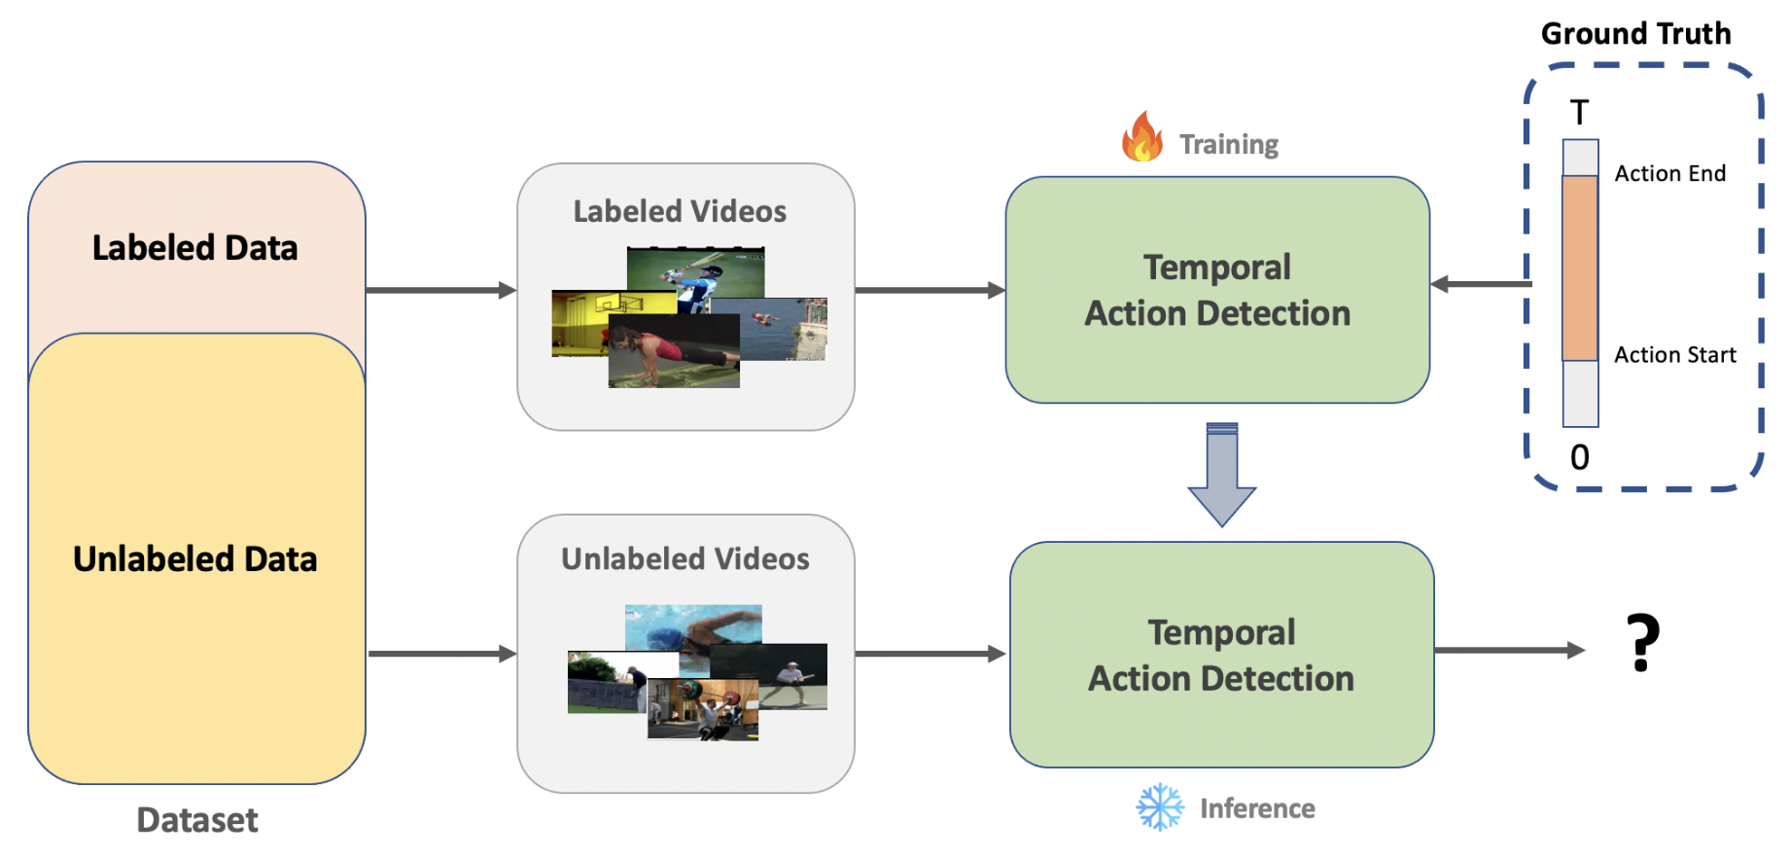
Semi-Supervised Temporal Action Detection
(A) High Cost of Annotation (B) Very few (~10-60% Videos) are annotated (C) High Detection Error

Slide 4
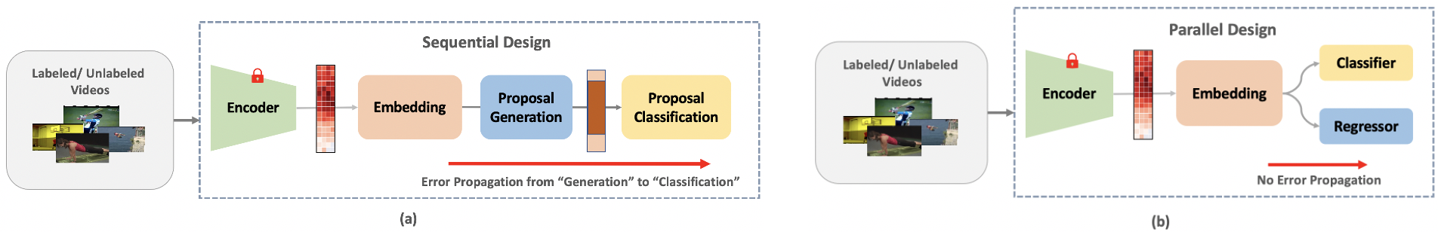
Prior Work
2 Stage Proposal-based Approach
Ex : SSTAP¹ ( CVPR21 )
Two Stage Network Design – 1) First Detect Action Boundary 2) Classify Action within boundary
1st stage error propagate into the 2nd stage
With less annotated data, this error accumulates
¹Wang, X., Zhang, S., Qing, Z., Shao, Y., Gao, C., Sang, N. “Self-supervised learning for semi-supervised temporal action" CVPR. 2021.

Slide 5
Prior Work
2 Stage Proposal-based Approach
Ex : SSTAP¹ ( CVPR21 )
Two Stage Network Design – 1) First Detect Action Boundary 2) Classify Action within boundary
1st stage error propagate into the 2nd stage
With less annotated data, this error accumulates
¹Wang, X., Zhang, S., Qing, Z., Shao, Y., Gao, C., Sang, N. “Self-supervised learning for semi-supervised temporal action" CVPR. 2021.

Slide 6
Our Solution
1 Stage Proposal-Free Approach
Ex : TAGS¹ ( ECCV22 )
Single Stage Network Design – Detect Action Boundary and Classify Action parallelly
1st stage error does not propagate further
With less annotated data, this error does not accumulate
Sauradip Nag, Xiatian Zhu, Yi-Zhe Song and Tao Xiang, ”Proposal-Free Temporal Action Detection via Global Segmentation Mask Learning" ECCV 2022.

Slide 7
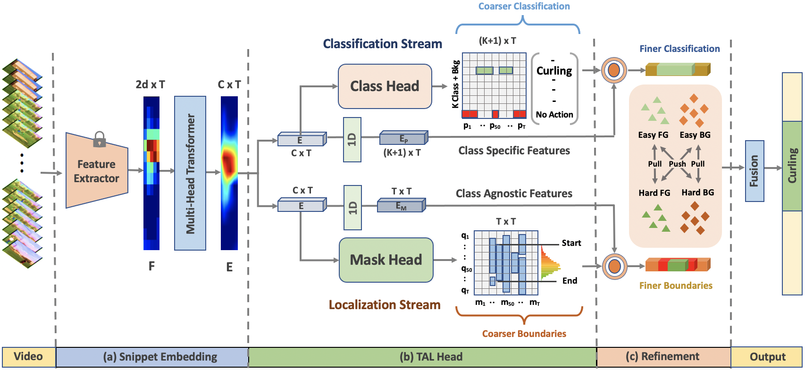
Architecture Design
Semi-SuPervised Temporal ActiOn DetecTion via Proposal-Free Masking (SPOT)

Slide 8
SPOT : Snippet Embedding
Goal : Given raw video frames, extract global
Feature embedding
Raw Video Frames are passed into a Frozen Video Encoder* to obtain Snippets
Each Snippet is passed into a Multi-Head Transformer ( Embedding Module ) to obtain the Global Context .
* Encoders ( I3D/C3D – ConvLSTM based ) are finetuned on Kinetics Dataset for Action Classification

Slide 9
SPOT : Action Detection Heads
Goal : Given a video embedding
detect action at coarse-level
Each Temporal Location (Snippet) is classified into one of (K+1) classes including background in Class Branch
Each snipped is also classified into a video-level global mask in Mask Branch
Even with one positive action snippet, we get a) Action Class b) Action Boundary

Slide 10
SPOT : Contrastive Boundary Refinement
Goal : Given coarse predictions,
refine the predictions at feature level
Snippets along Action-Boundaries are confusing
Parallel Branches have similar foreground features
Contrast between easy and hard examples to learn representation

Slide 11
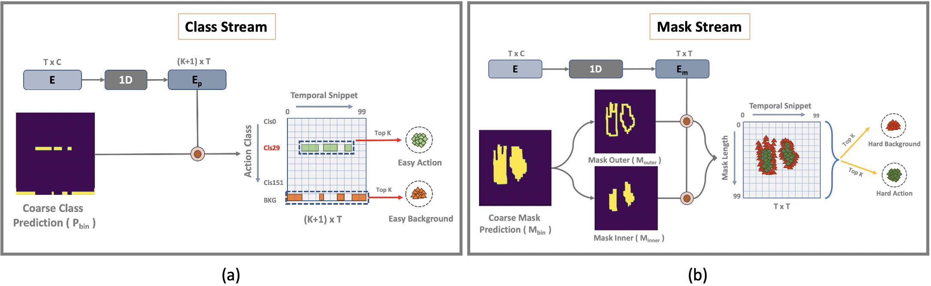
SPOT : Contrastive Boundary Refinement
Easy Background + Easy Action : Class Branch Features
Hard Background + Hard Action : Mask Branch Features
Apply Contrastive learning e.g, InfoNCE

Slide 12
SPOT : How to Train ?
Use Unlabeled Videos to Pre-Train the network in a Self-Supervised fashion
Then Finetune the network with the Few Labeled Videos in a Semi-Supervised fashion
We take a Pre-Train then Fine-Tune strategy to train our SPOT model

Slide 13
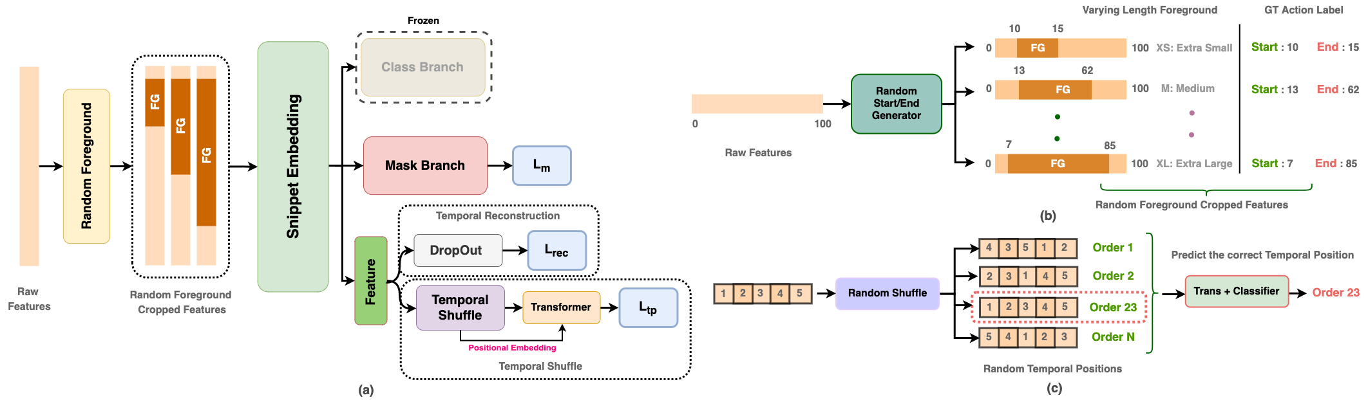
SPOT : Training Stage 1 → Self-Supervised Pre-Training
Proposed a novel pre-text task ”Random Foreground” which masks out the foreground features randomly
We then use 3 pre-text tasks on top (a) Start/End of mask (b) Temporal Dropping (c) Temporal Shuffle

Slide 14
SPOT : Training Stage 2 → Semi-Supervised Fine-Tuning
We load the Pre-Trained weights from Stage 1 training
We Fine-Tune SPOT using SSL Algorithm e.g, Pseudo Label

Slide 15
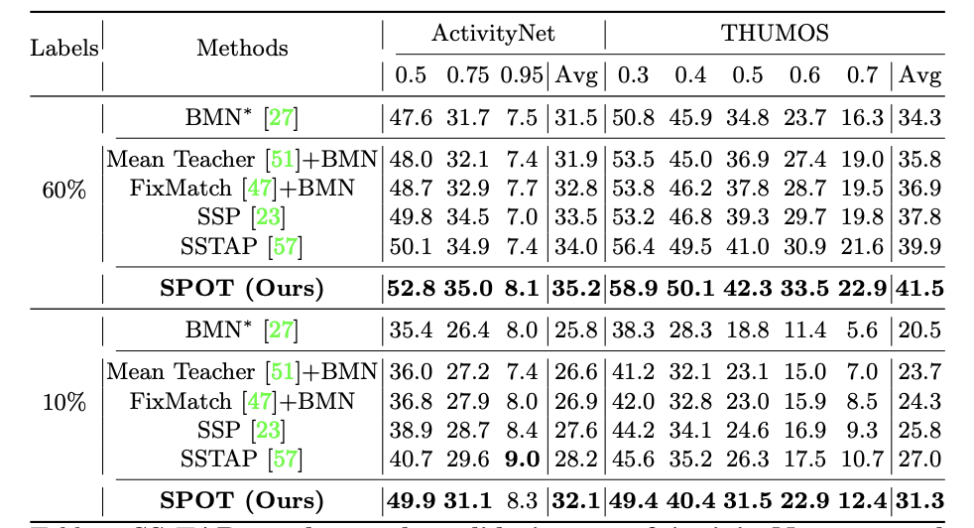


Quantitative Results : Semi-Supervised Setting
Datasets :
9k Training, 5k Testing Video
1.
Short Videos ( ~ 3-4 mins )
70% Long Single FG Instance
200 Training, 213 Testing Video
2.
Long Videos ( ~ 9-14 mins )
85% Short Multi FG Instance
Performance :
We reach new SOTA on both the Datasets
with just 10% Annotated videos we reach
SOTA by ~ 3.9 % on Avg mAP
and ~ 9.2 % on mAP@0.5
Table 1
Settings : 10% Annotated , 60 % Annotated

Slide 16
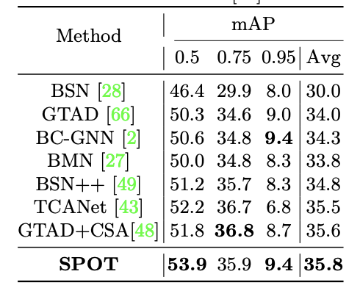
Quantitative Results : Fully-Supervised
Performance :
We reach SOTA on both the Datasets even in
Fully-Supervised Setting with our SPOT model.
We reach SOTA by ~ 0.2 % on Avg mAP
and ~ 2.1 % on mAP@0.5
Table 2

Slide 17
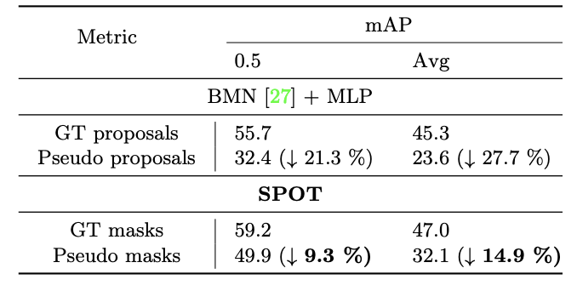
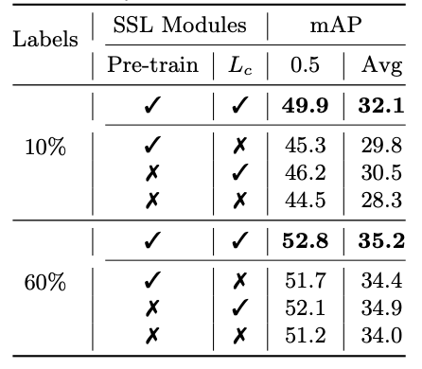
Ablation Studies
Table 3
Table 4
Localization Error Propagation
Impact of SSL modules

Slide 18
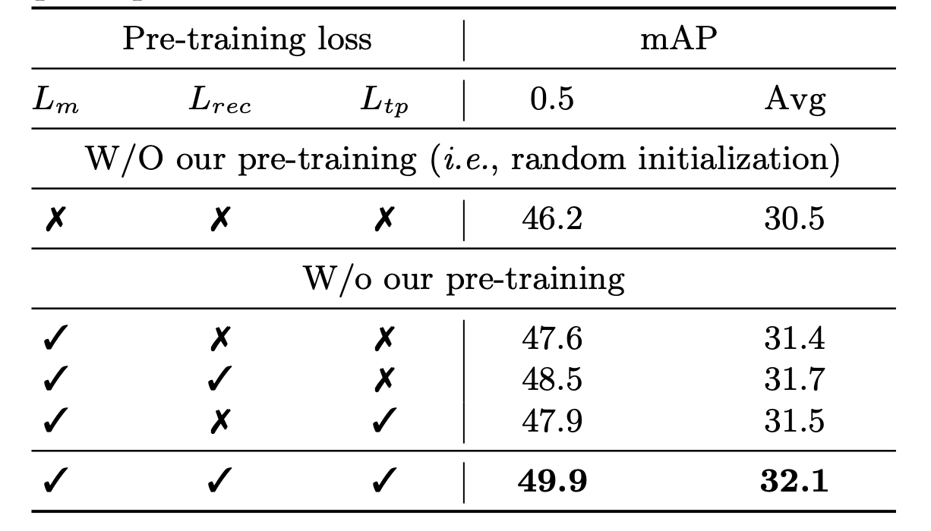
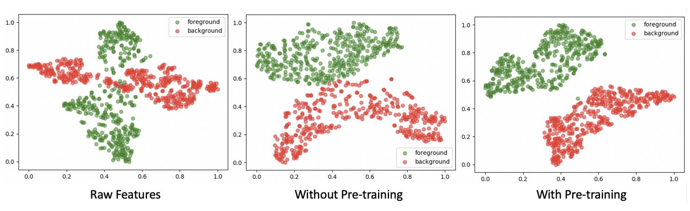
Ablation Studies
Table 5
Effect of Pre-Training
T-SNE Visualization of Pre-Training

Slide 19
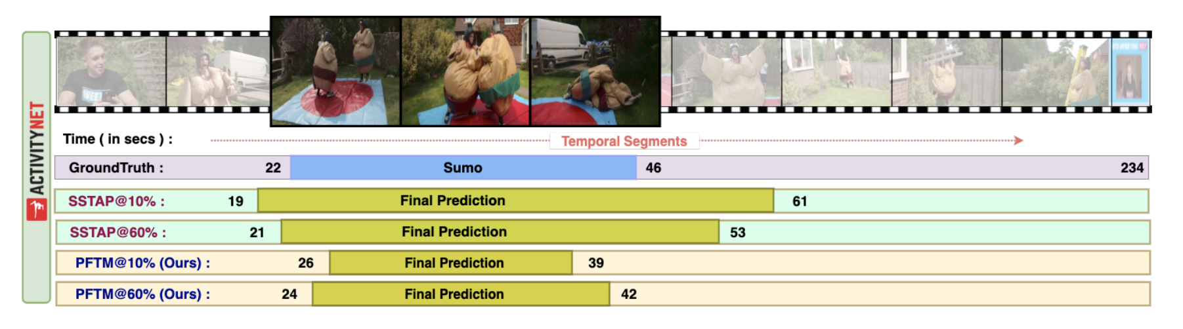
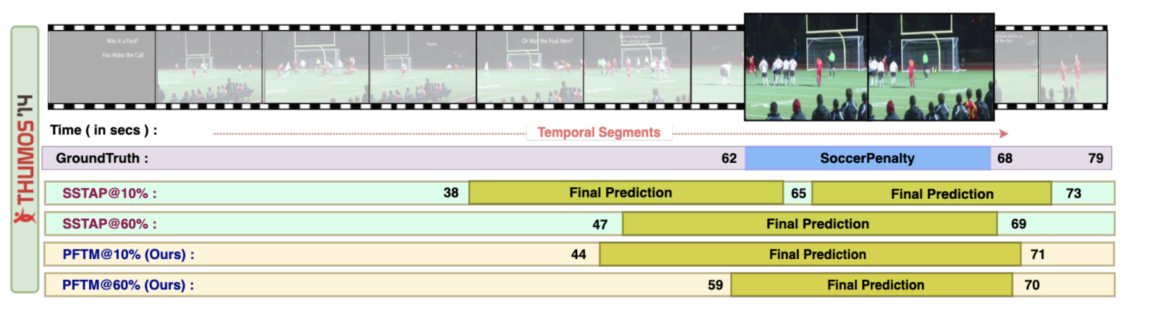
Qualitative Results
ActivityNet v1.3
THUMOS14

Slide 20

Thank You for Listening
Scan the QR Code for more details

